Slide 1
Jeopardy
312 Midterm 1 Review

Slide 2
Expression
Writing Methods
Misc.
Code Tracing
100
100
100
100
200
200
200
200
300
300
300
300
400
400
400
400
500
500
500
500

Slide 3
utcs1dh
“ut” + “cs” + 1+ “dh”
Row 1, Col 1

Slide 4
I’ll tell you if you are right!
Write a method that
would print
first 10 numbers
in descending order
1,2

Slide 5
DrawingPanel p = new DrawingPanel(100, 20);
Graphics g = p.getGraphics();
What objects do you need to use
g.drawLine(x,y,x1,y1);
1,3

Slide 6
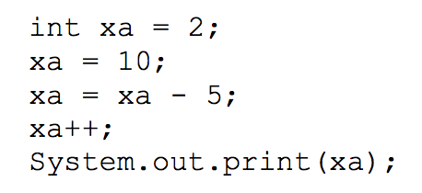
6
1,4

Slide 7
10.5
2.5 + 5 / 2 + (3 / 0.5)
2,1

Slide 8
I’ll check your answer!
Write a method named sumTo
that takes an integer parameter n
and returns the sum
1 + 1/ 2 + 1 /3 + ... + 1/ n .
2,2
Notes:
Fall 2010

Slide 9
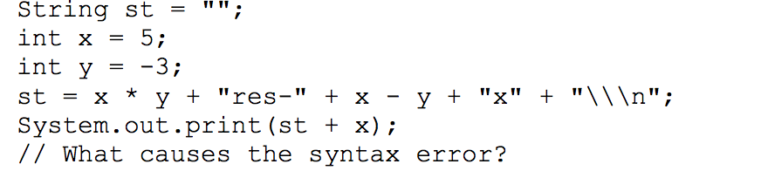
Subtract operation not overridden for strings
2,3

Slide 10
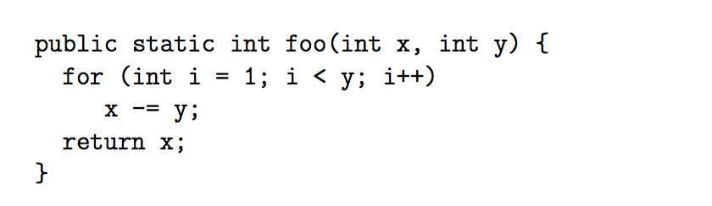
-1
foo(-1, 1);
2,4

Slide 11
13
20 % 7 + 7 % 20
3,1

Slide 12
(Type the question for 3,2 here.)?
.....11111
....2222
...333
..44
.5
3,2

Slide 13
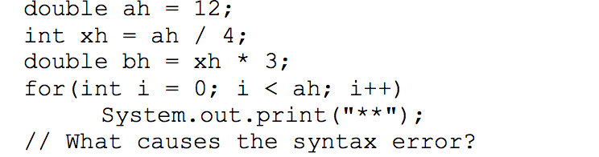
Cannot store an expression that results in a double in an int var. (Loss of precision.)
3,3

Slide 14
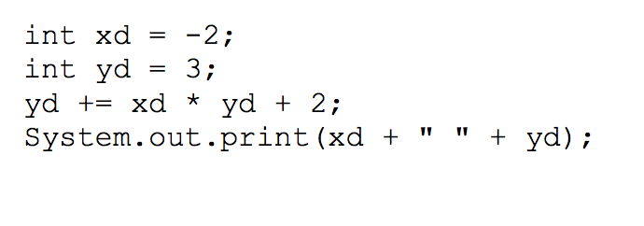
-2 -1
3,4

Slide 15
51
((int) 15.6) * 3 + 2 * 3
4,1

Slide 16
I’ll check your answer
**||||
****|||
******||
4,2
Notes:
Fall

Slide 17
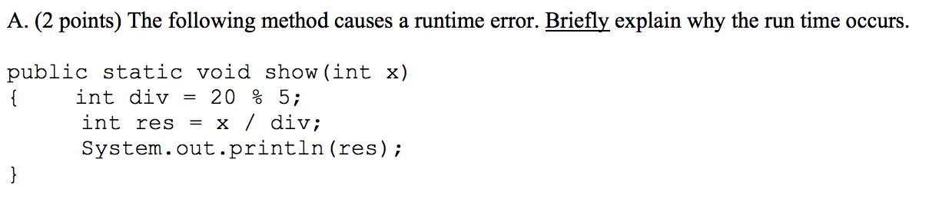
Divide by 0
4,3

Slide 18
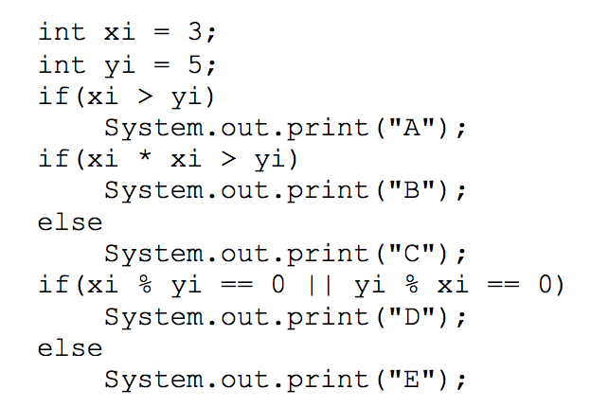
BE
4,4

Slide 19
5.5
Math.ceil(1.02) +
Math.floor(2.4) +
Math.abs(-1.5)
5,1

Slide 20
(Type the question for 5,2 here.)?
----*----
---***---
--*****--
-*******-
*********
5,2

Slide 21
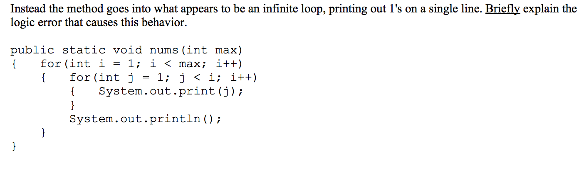
inner for loop increments i instead of j.
Type the answer for 5,3 here.
5,3

Slide 22
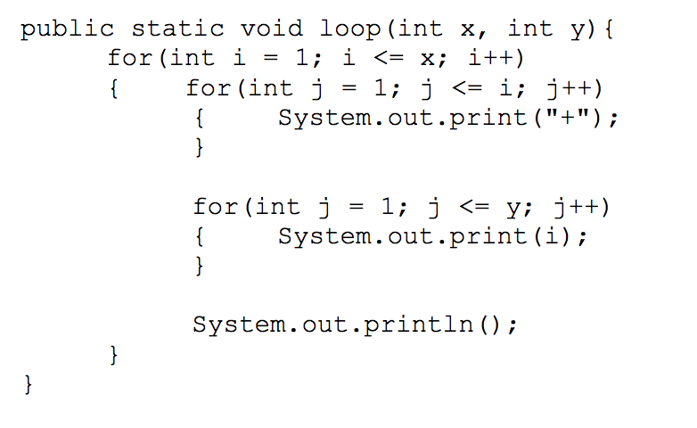
+11
++22
Loop(2,2)
loop(2,2)
5,4

